Slide 1
Content
SAP Overview
ABAP Dictionary/ Data Dictionary
ABAP Basics
Reports
Module Pool Programming
Layout Sets
Data Conversions
Modification and Enhancements
Connectivity
Notes:
First Slide

Slide 2
Content
Reports Overview and Its Parts
Selection Screen Design
Selection Screen Events
Classical Reports
Interactive Reports
Notes:
First Slide

Slide 3
ABAP Reports
Program and its Parts
Reports are executable programs which are used to display summarized
Information based on selection
Logic in the Report Program has been classified into 4 Blocks
Selection Screen Design and Handling
Data Fetching and Processing Logic
Display Basic List
Normal Reports: With Help of WRITE statement
ALV Reports: With help of Function Modules are Classes
Handle User Command and Display Subsequent Lists
ABAP is event driven program.
That Means
Write the Logic in the Events
That Means
Your logic will be distributed among events
There are several standard events provided by the SAP.
Reports are Executable programs – Program Type - 1
Reports
Overview
Selection Screen Design
Selection Screen Events
Classical Reports
Interactive Reports
ALV Reports

Slide 4
ABAP Reports
Selection Screen
Reports
Selection Screens are special screens which are used to enter values in an ABAP
Program and are created with help of ABAP statements such as
PARAMETERS
SELECT-OPTIONS
SELECTION-SCREEN
List of Selection Screen UI Elements
Parameters
Select-Options
Check Box
Radio Buttons
Push Buttons
Blocks
Sub Screens
Tab Strips
Lines
Comments
Overview
Selection Screen Design
Selection Screen Events
Classical Reports
Interactive Reports
ALV Reports
Note: Selection Screen is not an independent entity. Selection is part of the report

Slide 5
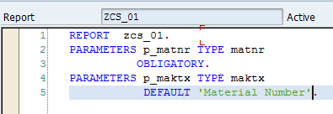
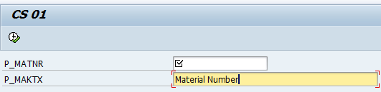
ABAP Reports
Selection Screen
Reports
Parameters:
It created selection screen and enters a single value in an ABAP program
Syntax:
PARAMETERS <p_name> TYPE/LIKE <data_type>
[decimals]
[DEFAULT <value>]
[OBLIGATORY]
[MODIF ID <key>]
Example:
Overview
Selection Screen: PARAMETERS
Selection Screen Events
Classical Reports
Interactive Reports
ALV Reports

Slide 6

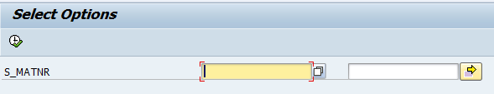
ABAP Reports
Selection Screen
Select Options:
It creates selection screen and enters a range of values in an ABAP program
Syntax:
SELECT-OPTIONS <s_tab> FOR <data_object>
Reports
Overview
Selection Screen: SELECT-OPTIONS
Selection Screen Events
Classical Reports
Interactive Reports
Extension
ALV Reports
S_MATNR-LOW
S_MATNR-HIGH

Slide 7
ABAP Reports
Selection Screen
Reports
SELECT-OPTIONS statement creates a Internal table with header line which contains 4 fields
SIGN
OPTION
LOW
HIGH
SIGN: its datatype is C. Length is 1. Values can be ‘I’ or ‘E’
I – Include
E – Exclude
Default value is ‘I’
OPTION: Its datatype is ‘C’ Length is ‘2’. It contains relational operator
Case#1: If High is empty then value can be EQ, LT, GT, LE, GE & NE
Case#2: if both low and high is not empty, value can be ‘BT’ or ‘NB’
LOW: Its datatype is same as datatype of <data_object>
HIGH: Its datatype is same as datatype of <data_object>
Overview
Selection Screen SELECT-OPTIONS
Selection Screen Events
Classical Reports
Interactive Reports
ALV Reports

Slide 8
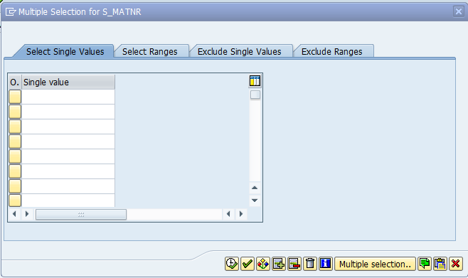
ABAP Reports
Selection Screen
Include Values
SIGN - E
Reports
Include Values
SIGN - I
Overview
Selection Screen SELECT-OPTIONS
Selection Screen Events
Classical Reports
Interactive Reports
ALV Reports
OPTIONS:
EQ, LT, GT, LE, GE & NE

Slide 9
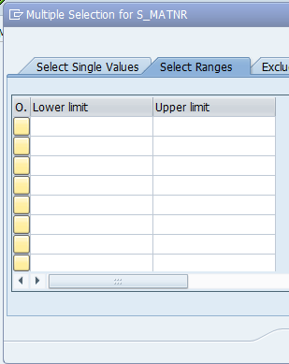
ABAP Reports
Selection Screen
Reports
We can provide range of values
Options: BT & NB
Overview
Selection Screen
SELECT-OPTIONS
Selection Screen Events
Classical Reports
Interactive Reports
ALV Reports
We can provide individual values

Slide 10
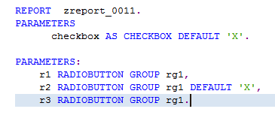
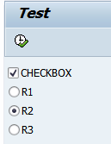
ABAP Reports
Selection Screen
Checkbox:
PARAMETERS <name> AS CHECKBOX DEFAULT ‘X’
Radio Button Group
PARAMETERS:
<Rad_1> RADIOBUTTON GROUP <grp1> DEFAULT ‘X’,
<Rad_2> RADIOBUTTON GROUP <grp1>,
<Rad_3> RADIOBUTTON GROUP <grp1>
Note: at least two Radio buttons will be assigned to single group
Reports
Overview
Selection Screen Checkbox & Radio Button Group
Selection Screen Events
Classical Reports
Interactive Reports
ALV Reports
Check box and Radio Buttons

Slide 11
ABAP Reports
Selection Screen
Blank Line
SELECTION-SCREEN SKIP 2
Horizontal Line and Underline
SELECTON-SCREEN ULINE
Screen Box
SELECTION-SCREEN: BEGIN OF BLOCK <blk_name> WITH FRAME TITLE <title>
[NO INTERVALS]
SELECTION-SCREEN: END OF BLOCK <BLK_NAME>
Comment
SELECTION-SCREEN /<POS> [LEN] <comment_name>
Position:
SELECTION-SCREEN POSITION <position>
Push Buttons
SELECTION-SCREEN PUSHBUTTON /<pos> [len] <push_name>
USER-COMMAND <fcode>
MODIF ID <key>
Reports
Overview
Selection Screen Others
Selection Screen Events
Classical Reports
Interactive Reports
ALV Reports

Slide 12
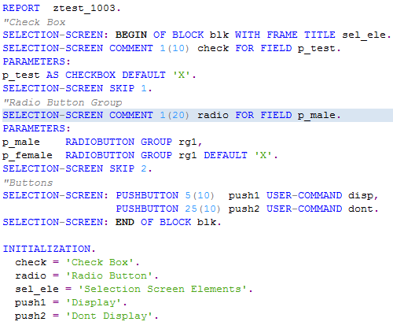
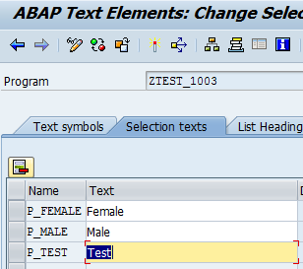
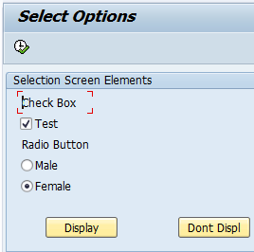
ABAP Reports
Selection Screen
Reports
Overview
Output
Selection Screen Example
Radio Buttons
Selection Screen Events
Classical Reports
Buttons
Interactive Reports
ALV Reports
Output
Replace Technical Names with Descriptions on output

Slide 13
ABAP Reports
Selection Screen: Events
Now its time to implement logic for selection screen UI elements
Events for Selection Screen
AT SELECTION-SCREEN OUTPUT
AT SELECTION-SCREEN ON <Field>
AT SELECTION-SCREEN
AT SELECTION-SCREEN ON VALUE-REQUEST FOR <field>
AT SELECTION-SCREEN ON HELP-REQUEST FOR <field>
Event Triggered Before Screen Display
AT SELECTION-SCREEN OUTPUT
Events to Handle User Action
Pressing Enter on Field
AT SELECTION-SCREEN ON <Field>
Pressing F4:
AT SELECTION-SCREEN ON VALUE-REQUEST FOR <field>
Pressing F1:
AT SELECTION-SCREEN ON HELP-REQUEST FOR <field>
At Last But Most Important
AT SELECTION-SCREEN
Reports
Overview
Selection Screen Design
Selection Screen Events
Classical Reports
Interactive Reports
ALV Reports

Slide 14
ABAP Reports
Selection Screen: Events
Reports
AT SELECTION SCREEN OUTPUT
This event is used to change the properties of selection screen elements such as
Mandatory, Disable, Invisible, Read-Only
AT SELECTION-SCREEN ON <field>
This event is used to validate a particular selection screen field <field>
AT SELECTION-SCREEN ON VALUE-REQUEST FOR <field>
This event is triggered when the user press F4 function key on selection screen field
AT SELECTION-SCREEN ON HELP-REQUEST FOR <field>
This event triggered when the user press F1 function key on selection screen field
AT SELECTION-SCREEN
This event triggered when user press F8 button. It is used to validate all the fields in the selection screen
Overview
Selection Screen Design
Selection Screen Events
Classical Reports
Interactive Reports
ALV Reports

Slide 15
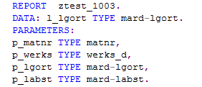
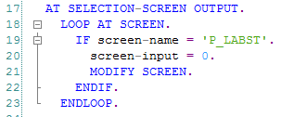
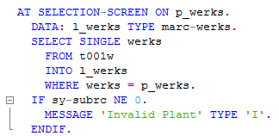
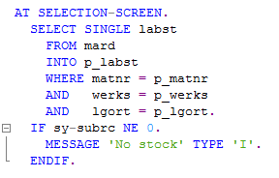
ABAP Reports
Selection Screen: Events
Selection Screen
Event: AT SELECTION-SCREEN OUTPUT
Making Stock field input disabled
Reports
Overview
Selection Screen Design
Selection Screen Events: Example
Event: AT SELECTION-SCREEN ON <filed>
To validate value in the field P_WERKS
Individual field validation
Classical Reports
Event: AT SELECTION-SCREEN
Collective validation for all fields.
Last Event triggered in the selection screen processing
Interactive Reports
ALV Reports

Slide 16
ABAP Reports
Report: Classical Reports
Reports are executable programs. Reports are used to display summarized
Information. Report Program contains following parts
Selection Screen
Data Fetching
Data Processing
Displaying
Subsequent Handling of User actions on Basic List
Types of Report
Classical Reports
Report program which is showing basic list. No further action can be
done on the output.
Interactive Reports
user can perform action(double click/Pressing button on application
Tool bar) basic list to display further lists
ALV Report
Above report will be displayed with help of WRITE statement. We will
Use ALV function modules/Classes to display data with better look and feel.
Reports
Overview
Selection Screen Design
Selection Screen Events
Classical Reports
Interactive Reports
ALV Reports

Slide 17
ABAP Reports
Report: Classical Reports
Events in Classical Report
INITIALIZATION:
This event will be executed only once. Purpose of this event is for validating authorization checks
Selection Screen Events
This set of events are used to process selection screen elements
START-OF-SELECTION
This event is used to initiate database selection
END-OF-SELECTION
This event is used to display content
TOP-OF-PAGE
This will be triggered when first WRITE statement executed. Generally for displaying header
END-OF-PAGE
This will be triggered when content reached to last line of current page
Reports
Overview
Selection Screen Design
Selection Screen Events
Classical Reports: Events
Interactive Reports
ALV Reports

Slide 18
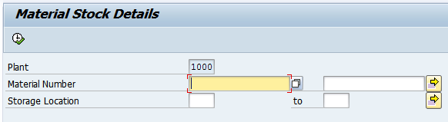
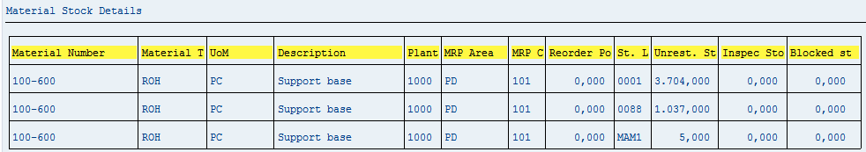
ABAP Reports
Report: Classical Reports
Example: Display Material Stock details
Input:
Plant - Parameter
Material Number – Select-Options
Storage Location – Select-Options
Reports
Overview
Selection Screen Design
Selection Screen Events
Classical Reports
Example
Interactive Reports
ALV Reports
Output

Slide 19
ABAP Reports
Report: Classical Reports
Reports
Validation:
Validate Plant in T001W
Validate Material, Plant and Storage Location in MARD Table
Data Fetching
Get Material Master data from MARA
Get Material Descriptions from MAKT
Get Material Plant Data from MARC
Get Material Stock from MARD
Processing:
Loop Storage Location Data
Read Material Master
Read Material Description
Read Material Data
Append data to the Final Table
Endloop
Output:
Display final internal table in the output
Overview
Selection Screen Design
Selection Screen Events
Classical Reports
Example
Interactive Reports
ALV Reports

Slide 20

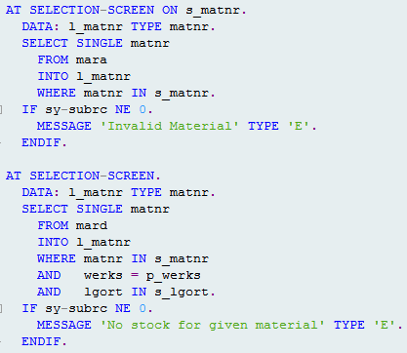
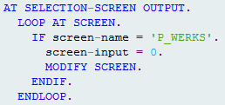
ABAP Reports
Report: Classical Reports
Selection Screen
Reports
Overview
Validation Logic
Selection Screen Design
Selection Screen Events
Selection Screen Output
Classical Reports
Example
Interactive Reports
ALV Reports

Slide 21
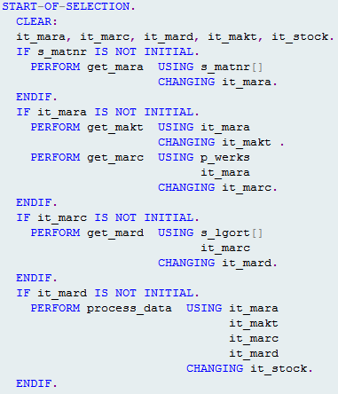
ABAP Reports
Report: Classical Reports
Data fetching and Processing Logic
Reports
Overview
Selection Screen Design
Selection Screen Events
Classical Reports
Example
Interactive Reports
ALV Reports

Slide 22
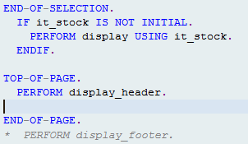
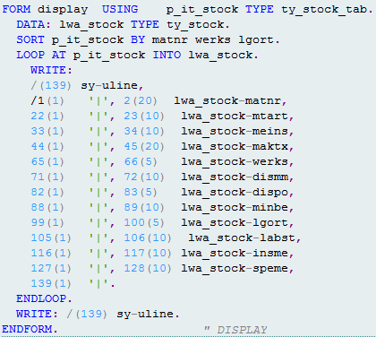
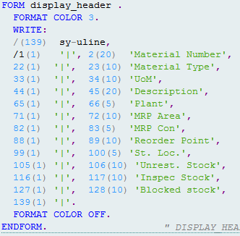
ABAP Reports
Report: Classical Reports
Reports
Data Display and Header Display
Display Data
Overview
Selection Screen Design
Selection Screen Events
Classical Reports
Example
Display Header
Interactive Reports
ALV Reports

Slide 23
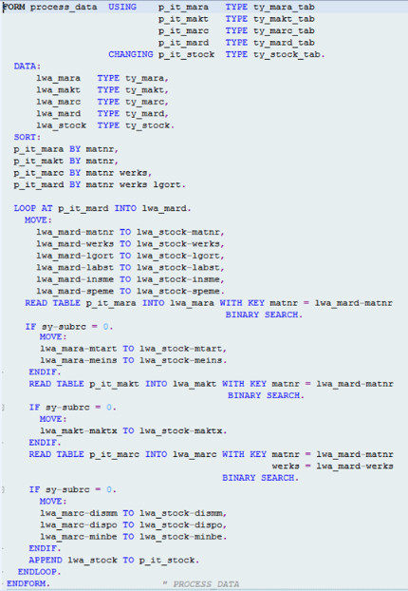
ABAP Reports
Report: Classical Reports
Processing Logic
Reports
Overview
Selection Screen Design
Selection Screen Events
Classical Reports
Example
Interactive Reports
ALV Reports

Slide 24
ABAP Reports
Report: Classical Reports
Report Header
No Standard Page Heading:
This option will avoid the standard Page heading.
Line-Count <count>:
it is used to create multiple pages and each page, number of lines
Are <count>
Example: Line-Count 20: each page contains 20 lines
Line-Count <Count>(Footer):
It is used to create multiple pages and each page, number of lines are <count>
In that count it will reserve <footer> number of lines for footer.
Example: Line-Count 20(4) each page contains total 20 lines and 4 lines reserved
for Footer. 16 for content and 4 for footer.
Line-Size <size>:
For specifying width of each line
Example: Line-Size 20.
Message-ID
For specifying message class so that in the rest of the program we can use short
Form of message
Reports
Overview
Selection Screen Design
Selection Screen Events
Classical Reports
Others
Interactive Reports
ALV Reports

Slide 25
ABAP Reports
Report: Classical Reports
Text Elements
Text that appear on the selection screen or output screen are called text elements. There are different types of text elements
Program or Report Title
List Heading
Column Heading
Selection Text
Text Symbols
Program or Report Title: It is the title of a program which describes the purpose of the program
List Heading: It is the first line of the output screen. Generally list heading is provided from the Title of the program
Column Heading: It is used to provide the headings for the column
Selection Text: It is used to replace the standard text that appears with the help
Parameters or select options
Text Symbols: These are the constants or text literals maintained outside of the
Program in order make the program independent of the language
Reports
Overview
Selection Screen Design
Selection Screen Events
Classical Reports
Text Elements
Interactive Reports
ALV Reports

Slide 26
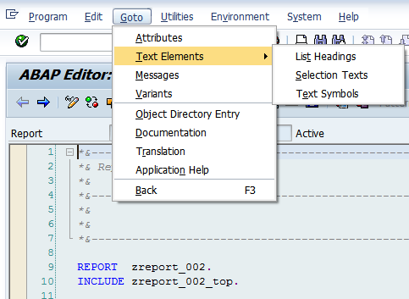
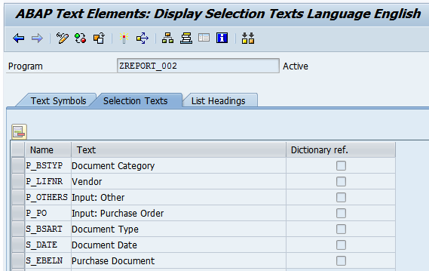
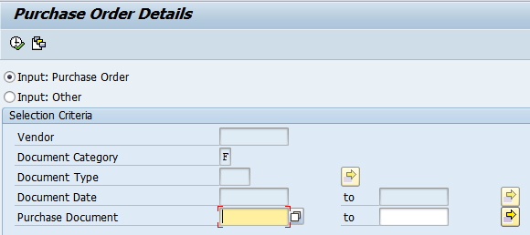
ABAP Reports
Report: Classical Reports
Navigation to Text symbols
SE38->Goto->Text Elements
Reports
Overview
Selection Screen Design
Selection Screen Events
Classical Reports
Text Elements: Selection Texts
Interactive Reports
Selection Text Tab: it is used to specify text for technical names
ALV Reports
Same text will be displayed on the selection screen. otherwise technical names will be display

Slide 27
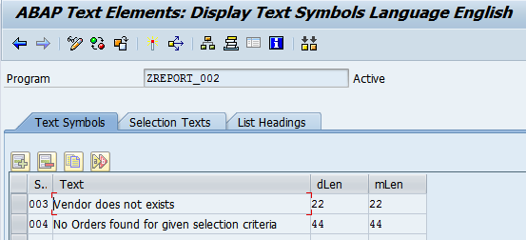
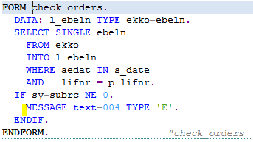
ABAP Reports
Report: Classical Reports
Text symbols are used to make text
Maintain outside of source code &
Language independent
Reports
Overview
Selection Screen Design
Selection Screen Events
Classical Reports
Text Elements
Text Symbols
Interactive Reports
ALV Reports
We can use text elements instead of literal text. During runtime, system will display text against text element

Slide 28
ABAP Reports
Report: Interactive Reports
Interactive reports also called Drill down reports.
Most general information will be displayed initially.
Whenever clicking on the line of the one list then it will navigate to display further data in subsequent lists
We can design unto 20 Secondary lists. In total with Basic List there are 21 List for
A program
Things to know to work with Interactive report
Events
System Variables
Keywords
GUI Status
Reports
Overview
Selection Screen Design
Selection Screen Events
Classical Reports
Interactive Reports
ALV Reports

Slide 29
ABAP Reports
Report: Interactive Reports
Reports
Events Used in Interactive Report
AT LINE-SELECTION
This event is triggered when the user double clicks on the basic list/secondary
List. Then detail information will be displayed on the next list
AT USER-COMMAND
This event is triggered when user selects a line and clicks on push button or Menu
Item then the further information will be displayed on next list
AT PF-KEY
This event is triggered when the user selects a line and clicks on function key on
Basic list or any next list
TOP-OF-PAGE DURING LINE-SELECTION
To display header for secondary lists
Overview
Selection Screen Design
Selection Screen Events
Classical Reports
Interactive Reports
ALV Reports

Slide 30
ABAP Reports
Report: Interactive Reports
Reports
System variables used in Interactive Reports
Overview
System Variable | Purpose
SY-LSIND | Contains current List Index
SY-LINSZ | Contains width of line of output screen
SY-LINCT | Contains number of lines per page
SY-LISEL | Contains content of the line from where the event was triggered
SY-LISTI | Contains list index number from where the event was triggered
SY-UCOMM | Contains the function code of the selected push button or Menu Item
SY-LINNO | Contains current line number
SY-PFKEY | Contains the current status or user interface
Selection Screen Design
Selection Screen Events
Classical Reports
Interactive Reports
ALV Reports

Slide 31
ABAP Reports
Report: Interactive Reports
Reports
Statements used in Interactive Reports
Overview
HIDE:
Hide is the command to store the content temporarily in the memory. Later
We can fetch hidden value by using the same variable. We should use only
Global variables to do it.
GET CURSOR
Get cursor is the statement is used to get the selected field and value on this
field
SY-LISEL
This system variable contains complete selected line
READ LINE
This statement will read the complete line in the report
Selection Screen Design
Selection Screen Events
Classical Reports
Interactive Reports
ALV Reports

Slide 32
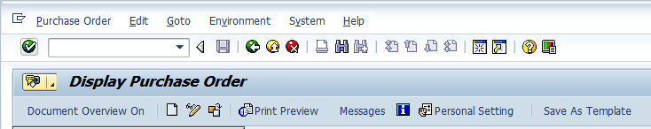
ABAP Reports
Report: Interactive Reports
Reports
GUI Status
It contains Menu Bar, Application Tool Bar with Push Buttons, Icons etc.
So that user can more easily interact with the system.
Menu painter is an ABAP workbench tool used to design user interface or status.
Transaction: SE41. GUI status will exists for each screen the program
Example: ME21 Initial Screen Status.
Overview
Selection Screen Design
Selection Screen Events
Classical Reports
Interactive Reports
Menu Bar
ALV Reports
Standard Tool bar
Application Tool bar

Slide 33
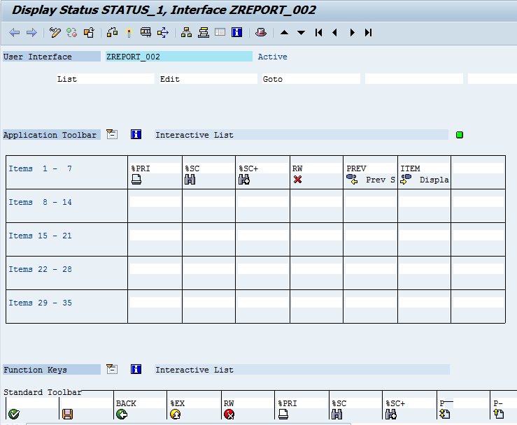
ABAP Reports
Report: Interactive Reports
Transaction: SE41
Report: ZREPORT_002 Status: STATUS_1
Reports
Overview
Menu Bar
Selection Screen Design
Selection Screen Events
Application Tool Bar
Classical Reports
Interactive Reports
ALV Reports
Standard Tool Bar

Slide 34
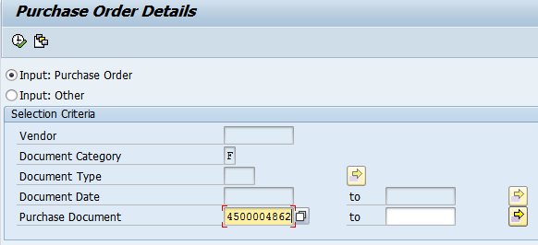
ABAP Reports
Report: Interactive Reports
Example:
Input:
Purchase Document
OR
Vendor
Document Category
Document Type
Document Date
Output:
Basic List: Purchase Header Data
First Secondary List: Purchase Item when clicking on Basic List
Second Secondary List: Purchase Sch. Line when clicking on first Secondary List
Reports
Overview
Selection Screen Design
Selection Screen Events
Classical Reports
Interactive Reports
ALV Reports

Slide 35
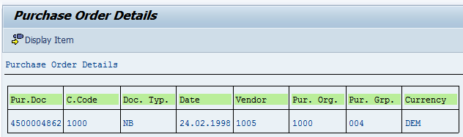
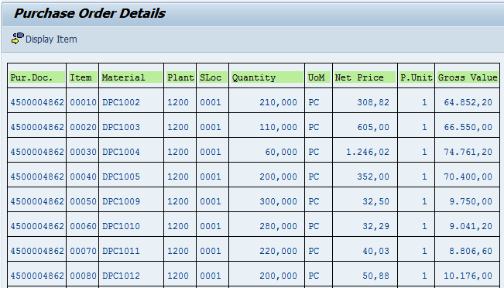
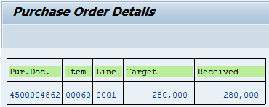
ABAP Reports
Report: Interactive Reports
Reports
Basic List: Header Data
Overview
Selection Screen Design
Selection Screen Events
Classical Reports
Interactive Reports
First Secondary List:
Purchase Item Details
ALV Reports
Second Secondary List:
Purchase Sch. Lines

Slide 36
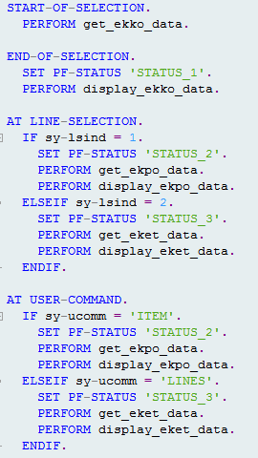
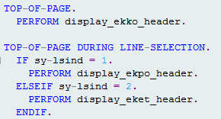
ABAP Reports
Report: Interactive Reports
Reports
Program flow logic
Start-of-Selection
End-Of-Selection
Handling Line selection &
User command
Overview
Selection Screen Design
Selection Screen Events
Output Header
Changing header for each list
Purchase Header
Purchase Item
Schedule Lies
Classical Reports
Interactive Reports
Example
ALV Reports

Slide 37
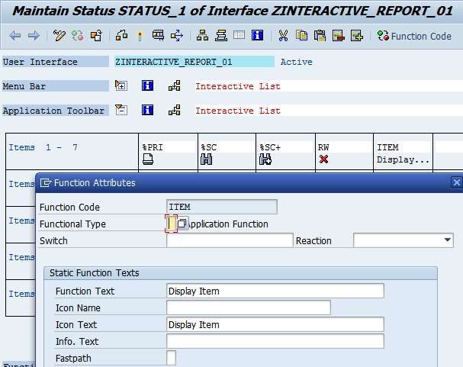
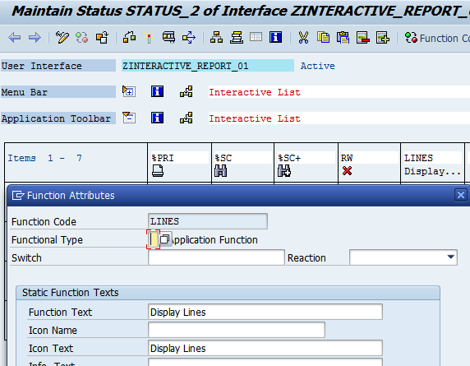
ABAP Reports
Report: Interactive Reports
Reports
GUI Status for Basic List
Overview
Selection Screen Design
GUI Status for First Secondary List
Selection Screen Events
Classical Reports
Interactive Reports
Example
ALV Reports

Slide 38
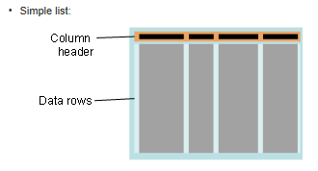
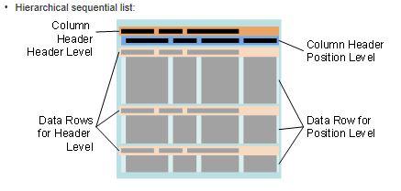
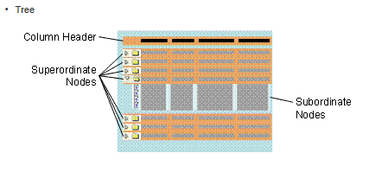
ABAP Reports
Report: ALV Reports
ALV – ABAP List Viewer or SAP List Viewer
The SAP List Viewer is a generic tool that outputs data in a table form (rows and columns), with integrated functions to manipulate output (sort, totals, filter, column order, hide, etc.) and export it (Excel, Crystal report, CSV files, etc.) It is also possible to make ALV editable via ALV control.
Reports
Overview
Selection Screen Design
Selection Screen Events
Classical Reports
Interactive Reports
ALV Reports

Slide 39
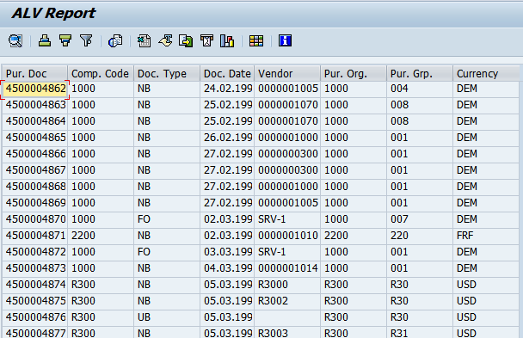
ABAP Reports
Report: ALV Reports
Tool Bar. We have standard functionalities. We can exclude existing functionalities or we can add our own functionalities
Reports
Overview
Selection Screen Design
Selection Screen Events
Classical Reports
Interactive Reports
ALV Reports
Data grid: we have data arranged in columns. Each columns has some set of properties including data type length and column header etc.

Slide 40
ABAP Reports
Report: ALV Reports
We will use some set of function modules (APIs) to work with ALV Reports
REUSE_ALV_VARIANT_DEFAULT_GET
REUSE_ALV_VARIANT_F4
REUSE_ALV_VARIANT_EXISTENCE
REUSE_ALV_EVENTS_GET
REUSE_ALV_COMMENTARY_WRITE
REUSE_ALV_FIELDCATALOG_MERGE
REUSE_ALV_LIST_DISPLAY
REUSE_ALV_GRID_DISPLAY
REUSE_ALV_POPUP_TO_SELECT
TYPE-POOLS: SLIS
Reports
Overview
Selection Screen Design
Selection Screen Events
Classical Reports
Interactive Reports
ALV Reports

Slide 41
ABAP Reports
Report: ALV Reports
Function Module: REUSE_ALV_GRID_DISPLAY
Some Important parameters
SY-REPID: Calling Program
Data: Actual data to be displayed
Structure Name OR Field Catalog:
Any of the parameter is used to specify the column properties(data type, length and description etc.) of ALV grid with ref to Data Dictionary reference or using field catalog
Subtotals: if subtotal to be displayed then we will use this parameters
Filtering: we can initially specify the filtering
Events Handling: we can handle user actions on ALV grid with help of event
Event handling methods
Reports
Overview
Selection Screen Design
Selection Screen Events
Classical Reports
Interactive Reports
ALV Reports

Slide 42
ABAP Reports
Report: ALV Reports
Specifying Column properties
Structure Name:
we can specify any of the data dictionary structure or Table name if same list of fields, you want to display in the ALV. So all the properties(Data type, Length, Description) can be applied from Data dictionary structure.
OR
Field Catalog:
If there is no exact structure/table exists in data dictionary in the Data dictionary then we can supply column properties with help of Field catalog. It can be built in three ways.
Automatically: Using Function Module REUSE_ALV_FIELDCATALOG_MERGE
Semi Automatically
Manually
Some important properties of each column including
Field Name
Table Name
Ref Table Name
Ref Data Type
Short Description
Key field
Sum
Hot Spot
Reports
Overview
Selection Screen Design
Selection Screen Events
Classical Reports
Interactive Reports
ALV Reports

Slide 43
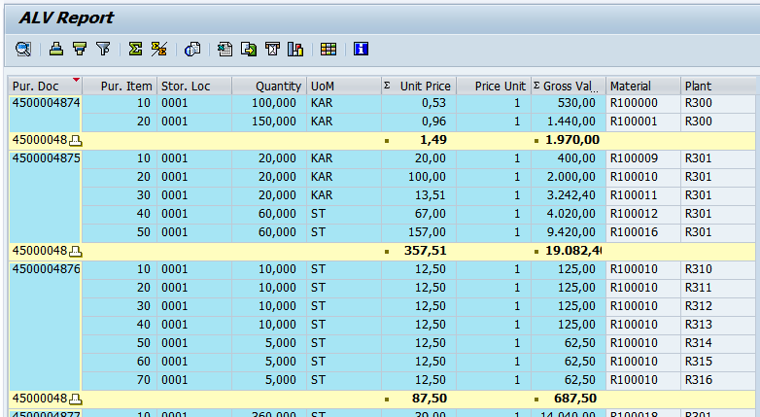
ABAP Reports
Report: ALV Reports
Reports
Subtotals:
Subtotals can be displayed with help of IT_SORT importing parameter
Overview
Selection Screen Design
Selection Screen Events
Classical Reports
Interactive Reports
ALV Reports

Slide 44

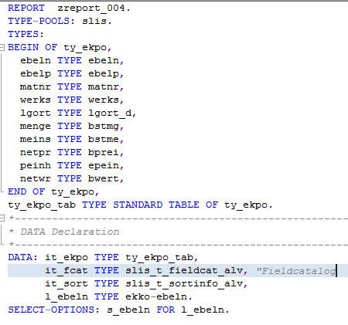
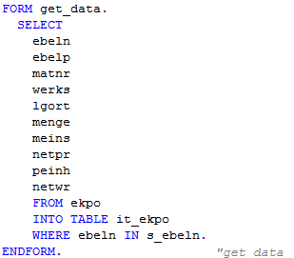
ABAP Reports
Report: ALV Reports
Example
Types, Data & Selection Screen
Declaration
Reports
Overview
Selection Screen Design
Program Flow
Selection Screen Events
Classical Reports
Interactive Reports
ALV Reports
Get Data

Slide 45
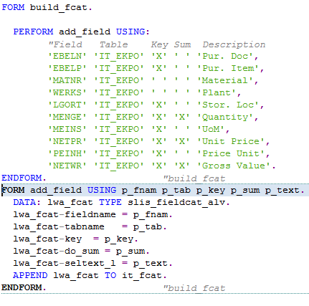
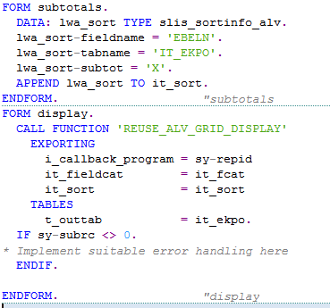
ABAP Reports
Report: ALV Reports
Reports
Overview
Selection Screen Design
Selection Screen Events
Classical Reports
Interactive Reports
ALV Reports
Subtotals and ALV Display
Field Catalog population

Slide 46
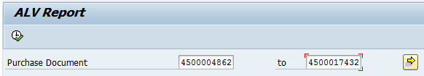
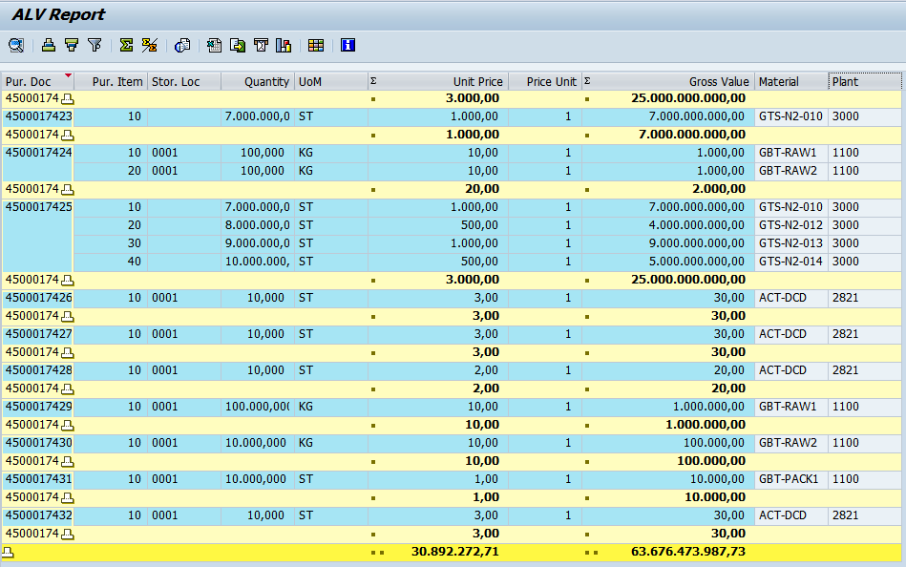
ABAP Reports
Report: ALV Reports
Selection Screen
Reports
Overview
Selection Screen Design
Selection Screen Events
Classical Reports
Interactive Reports
Subtotals
ALV Reports
Grand Totals

Slide 47
ABAP Reports
Report: ALV Reports
Interactive ALV:
we can navigate from one ALV list to another ALV list by performing some action the report. There are several events which help us to perform actions on ALV reports
Events:
USER-COMMAND: it is used to implement the logic to handle double click or single click on HOTSPOT field
Reports
Overview
Selection Screen Design
Selection Screen Events
Classical Reports
Interactive Reports
ALV Reports

Slide 48
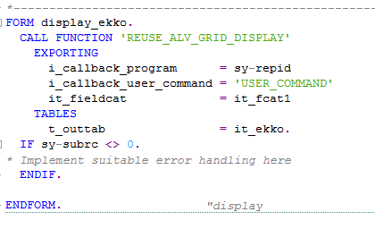


ABAP Reports
Report: ALV Reports
Example: Navigate from Purchase Header data to Purchasing Item data
Handle Double Click event
Reports
Overview
Specify the subroutine name
Selection Screen Design
Selection Screen Events
Classical Reports
Implement the subroutine.
Interactive Reports
ALV Reports
HOTSPOT in field catalog

Slide 49


ABAP Reports
Report: ALV Reports
Reports
Double click on the record or single click on Purchase Doc to navigate to the item list
Overview
Selection Screen Design
Selection Screen Events
Classical Reports
Interactive Reports
ALV Reports
Purchase Items

